Slide 1
Sungkeun Kim – Internship Summary
Rapid automation – analysis for developers (RAAD)

Slide 2


Agenda
My journey towards RAAD team and beyond.
RAAD Report and DF049 Assert reproduction
Autoperf on BHB

Slide 3
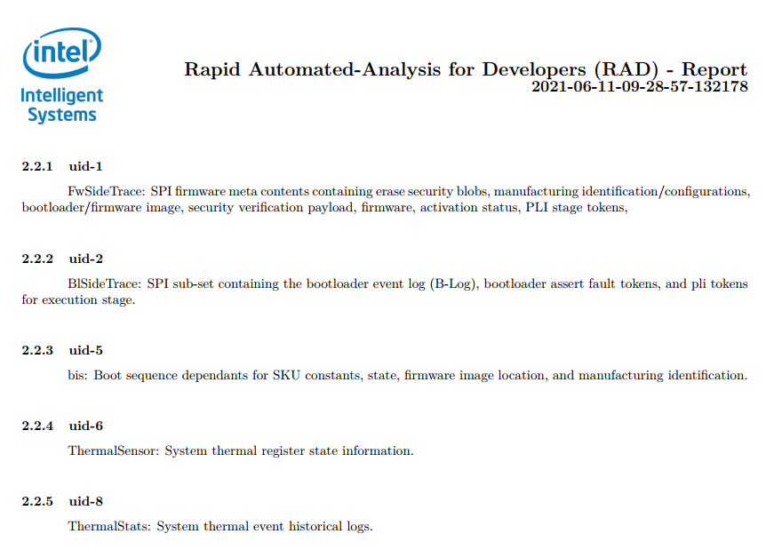
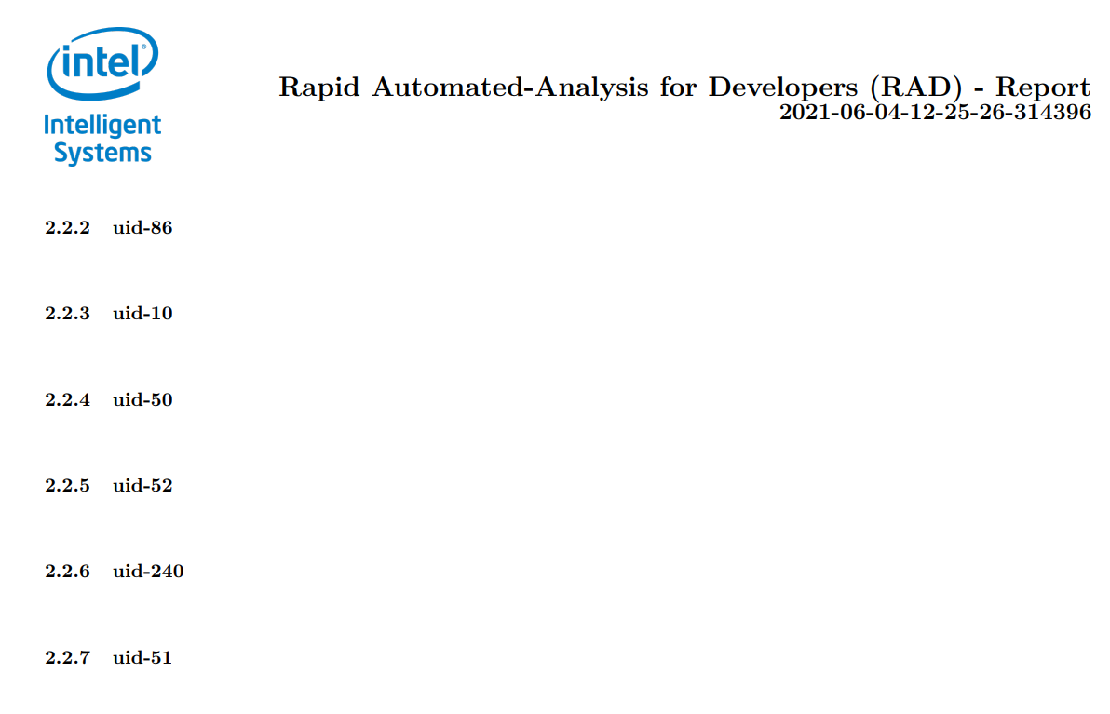
RAAD report (UID description)

Slide 4
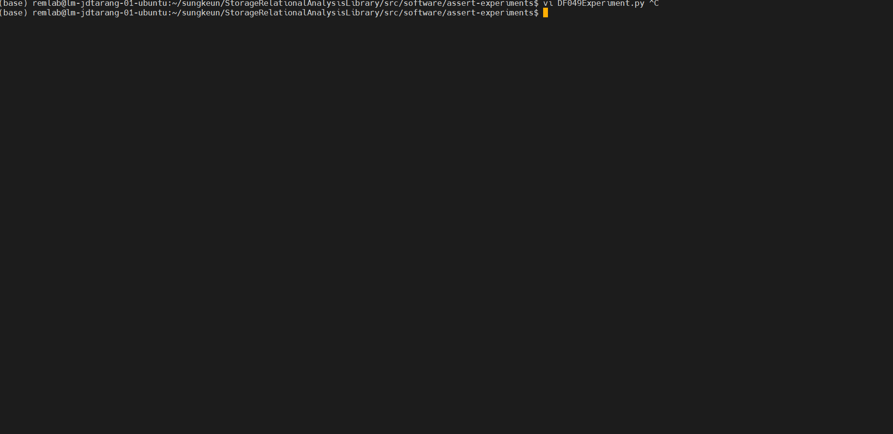
DF049 Reproduction

Slide 5



What is Autoperf?
Intel Labs MPR - Autoperf
Identifies performance degradation included in the new source version.
Autoencoder for a machine learning model (anomaly detection)

Slide 6
Need for the extension
PAPI library in Linux, X86
No support for HWPCs collection in FreeRTOS, ARM (A53)
Main Goal: enable HWPCs collection in BHB

Slide 7
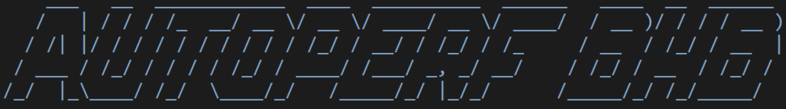
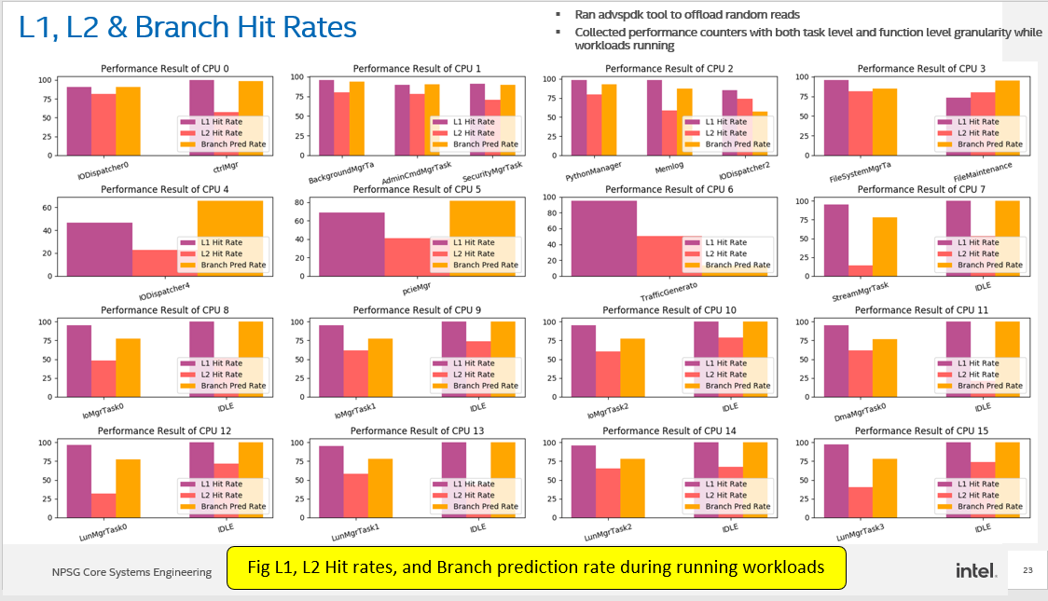
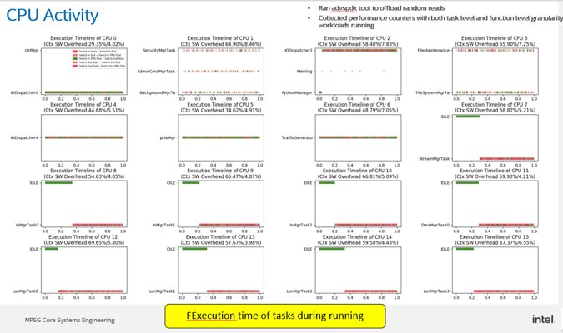
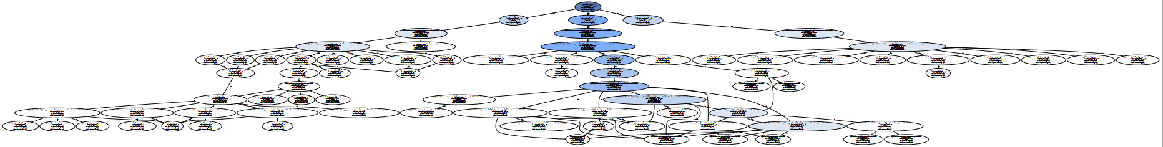
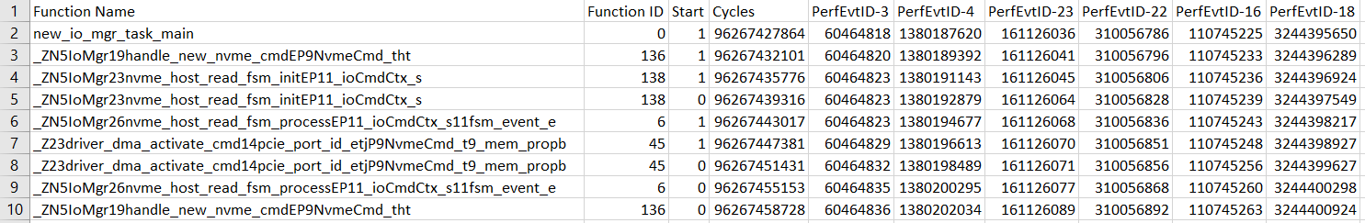
What to extend?
FreeRTOS extension
Save/Restore HWPCs to/from TCB
Automated source code instrumentation
Autoperf-LLVM
Select functions of interests using Callgraph
Runtime PMU control
Start/Stop PMU
Regerister performance events at runtime
Post processing HWPCs
Visulization for manual analysis
Train/Test Dataset for AutoperfAI

Slide 8
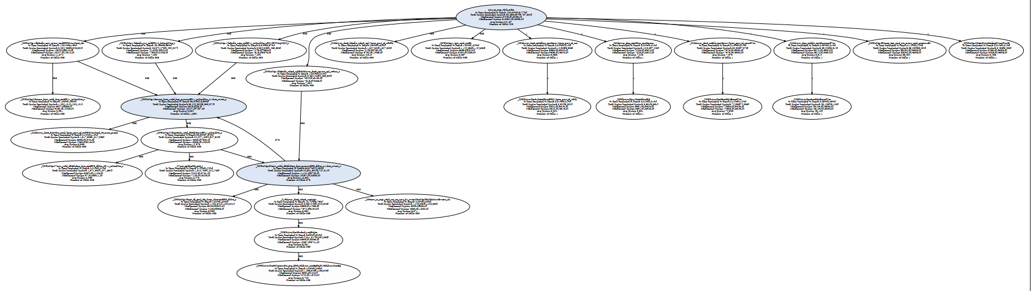
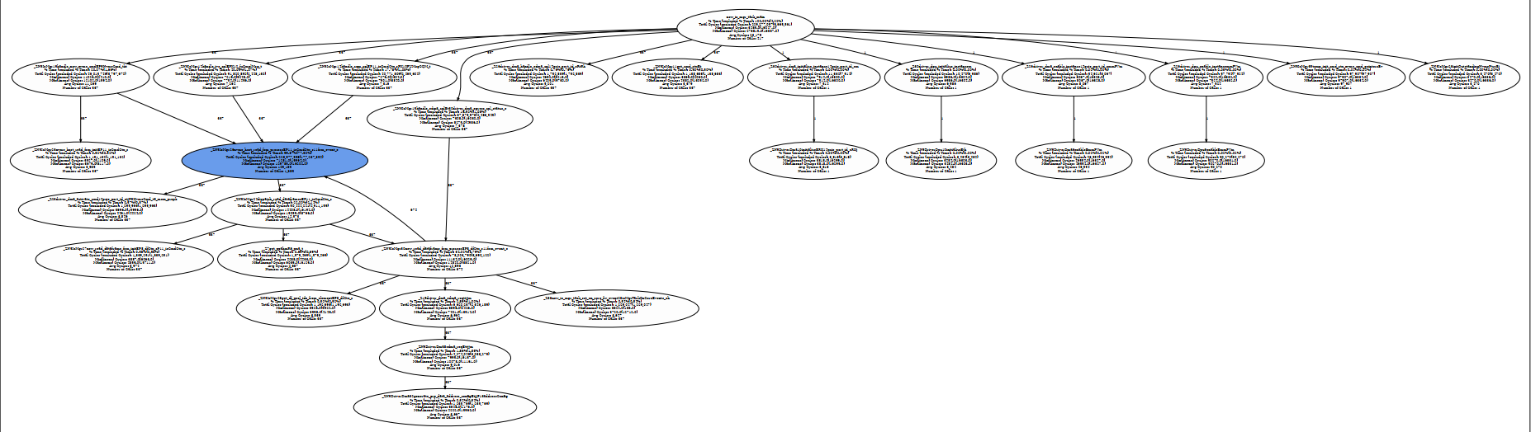
Result

Slide 9
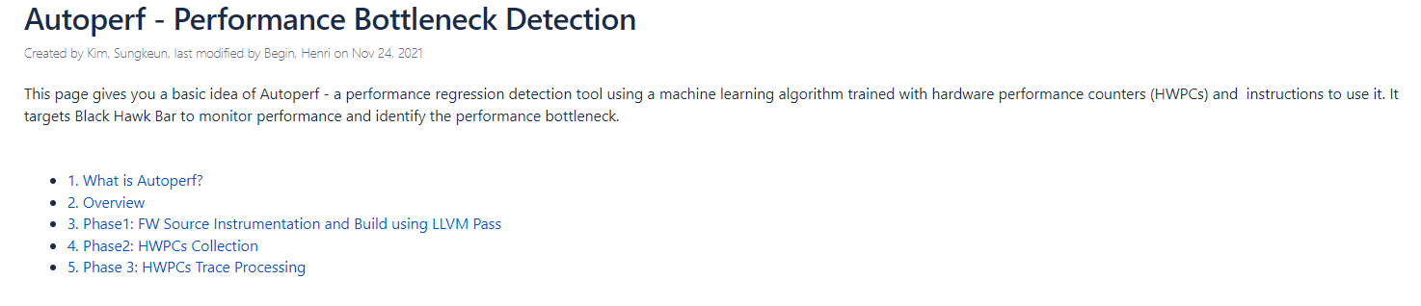
Autoperf wiki (link)

Slide 10
This work will go on
Minimize performance overhead due to instrumented function
Training and testing AutoperfAI using HWPCs from BHB
Validate HWPCs with other performance monitoring tools (logic analyzer)

Slide 11

Special Thank you
Manager:
Jim Baca
Intern Mentor:
Joe Tarango
BHB Mentor:
Craig Valine
Intel MPR Lab:
Justin Gottschelich
Teammates:
Daniel Garces
Rogelio Macedo
Stella Cao Aghalya Manmatharaj

Slide 12
THANK YOU
Notes:
THANK YOU

Slide 13


Notes:
END OF PRESENTATION

